Slide 1
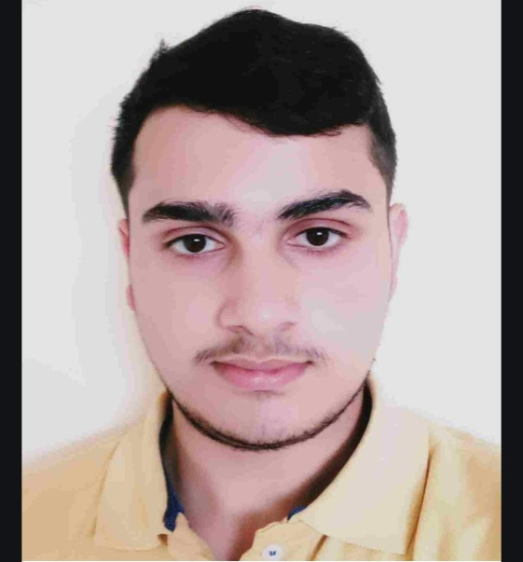
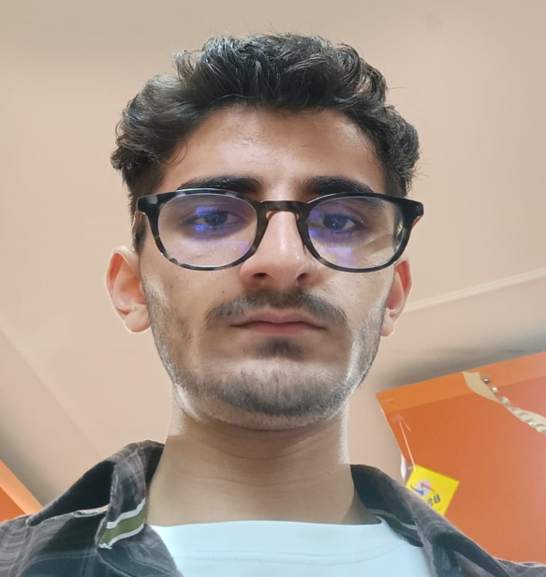
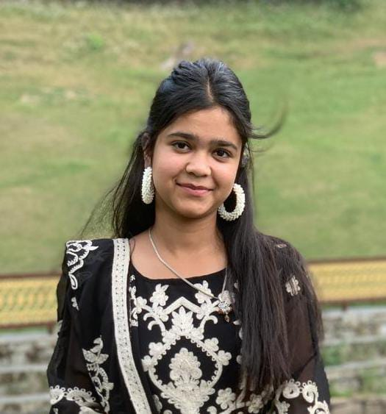
Meritorious students of Department of Botany
Session 2023-24
evers
Dixant Maudgill
Rank-15 in CUET
Pursuing M.Sc. Botany from Banaras Hindu University
Neeraj Thakur
Rank-1 (HPU MSc Microbiology and Biotechnology Entrance
Rank-81 AIIMS New Delhi Medical Biotechnology Entrance
Shagun Sharma
Pursuing M.Sc. Environment Science from Himachal Pradesh University Shimla.

Slide 2
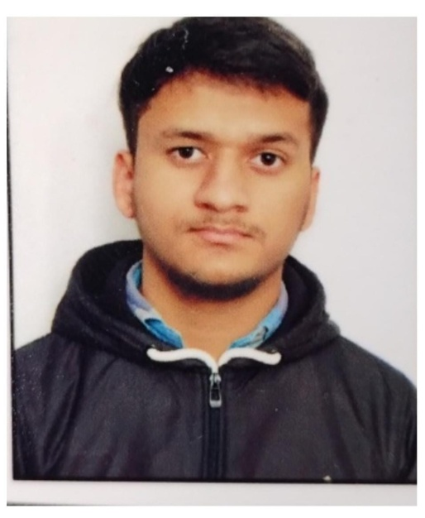
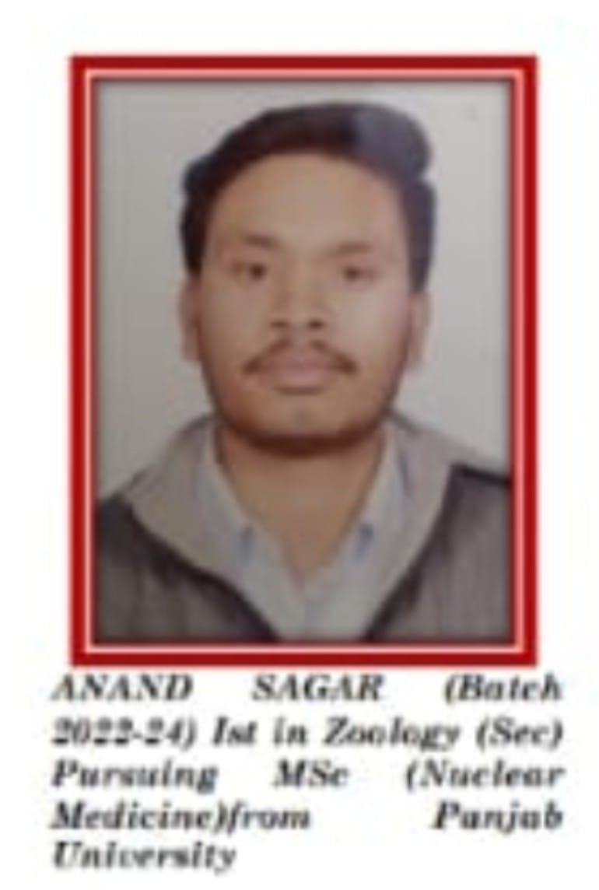
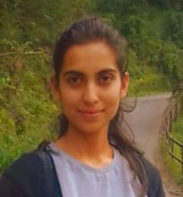

Parveen Sharma
2nd Rank in college merit list
Pursuing M.Sc. Zoology from IGNOU
Anand Sagar
Pursuing M.Sc. Nuclear Medicine from Panjab University
Anita Kashyap
3rd Rank in College Merit list
Parthik Negi
Pursuing M.Sc. Zoology from DAV PG College Dehradun.

